Slide 1


Review of the Week
First steps in Solidity, Writing Smart Contracts and Building DApps
Sevgin Mustafov
Blockchain Developer & Course Developer
Academy School of Blockchain
http://kingsland.academy

Slide 2
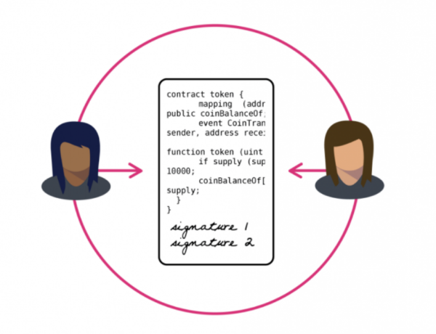




Table of Contents
Ethereum Virtual Machine
Data Types in Solidity
Visibility
Fallback Function
Libraries
Error Handling
Ethereum Tools

Slide 3

Smart Contracts and Solidity Basics
Architecture of DApps, Brief Story of Solidity, Ethereum VM

Slide 4
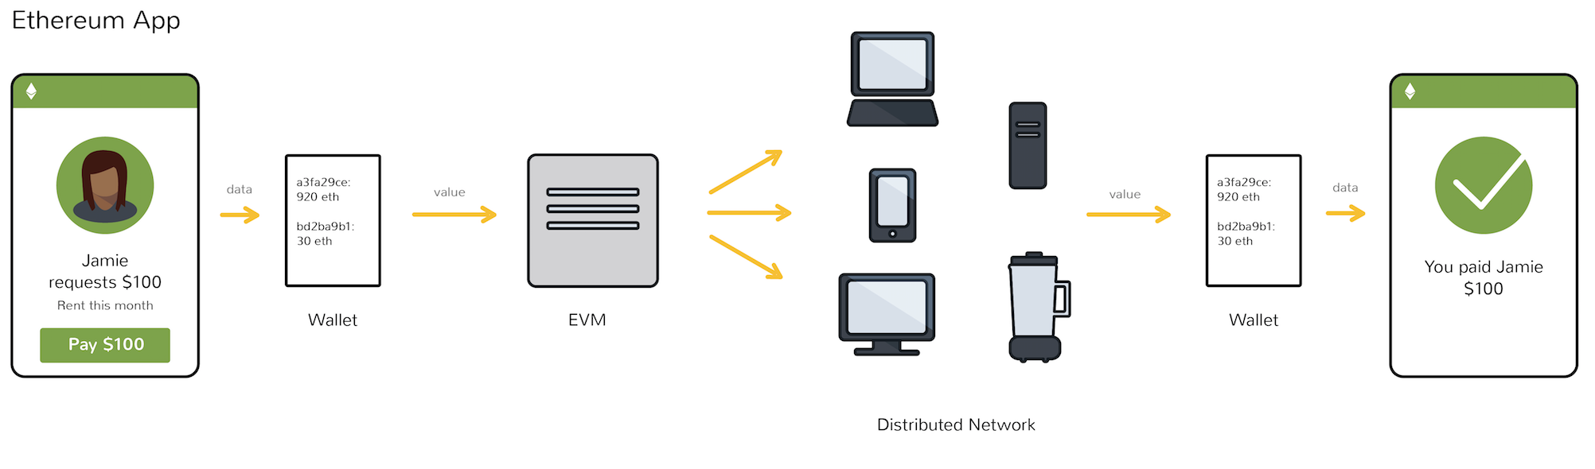
What is the Ethereum Virtual Machine (EVM)?
Focuses on providing security and executing untrusted code
Ethereum contracts are executed in the EVM
Contract rules are initially programmed
Through a stack-based bytecode language (Solidity)
Are compiled into bytecode

Slide 5
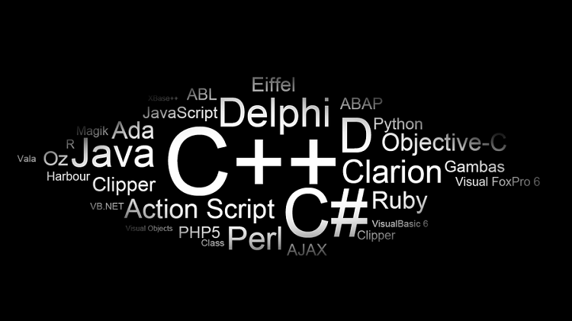
What is EVM used for?
EVM is a perfect testing environment
Smart contracts can be created using the EVM
EVM is implemented in Python, Ruby, C++ and other languages
Notes:
Since the Ethereum Virtual Machine is completely isolated from the rest of the main network, it is a perfect testing environment. Any company looking to create a smart contract can do so using the EVM, without it affecting the main blockchain operations. Testing this technology is of the utmost importance, as flawed code can spell demise for even the most exciting of smart contracts. Moreover, one could look at the EVM as a “learning environment” to build bigger, better, and more robust smart contracts as well.
It is also worth mentioning every Ethereum node in the network runs their own EVM implementation and is capable of executing the same instructions. It is evident there is a bright future ahead for this project, as it will continue to receive some updates over time. It is a gateway to building proper smart contracts, both for novice and experienced coders looking to get a hands-on approach with the Solidity language. Additionally, the EVM have been implemented in Python, Ruby, C++, and a few other coding languages.

Slide 6
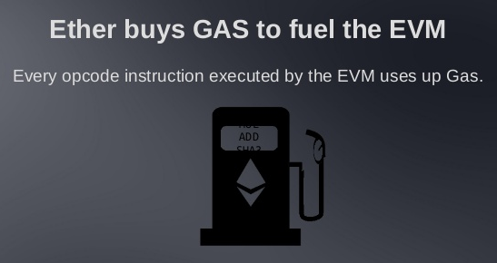
What is Gas in Ethereum network?
The internal unit for keeping track of execution cost
The mechanism of Gas solves two major issues:
A validator is guaranteed to receive a maximum of the initial pre-paid amount
Execution can not run longer than the pre-paid amount would allow
Notes:
The internal unit for keeping track of execution cost is called Gas and is the Ethereum network’s cost unit, paid exclusively with Ether— Ethereum’s own crypto-currency. The Gas mechanism solves two major issues:
A validator is guaranteed to receive a maximum of the initial pre-paid amount, even if the execution fails;
Sidestep the halting problem, i.e. an execution can not run longer than the pre-paid amount would allow. Instead of looping indefinitely the execution would exhaust the available resources that it has at its disposal.

Slide 7
Data Types in Solidity
Data types are similar to most programming languages:
int8 / uint8, … uint256 (uint) – integers of 8 … 256 bits
No floating-points numbers (still)
bool – true / false value
string – UTF8-encoded text, e.g. "Hello, Solidity!" or ""
address – Ethereum address (EIP 55 encoded)
e.g. 0xdCad3a6d3569DF655070DEd06cb7A1b2Ccd1D3AF
enum – enumerated type
enum YesNo {Yes, No}
YesNo answer = YesNo.Yes;

Slide 8
Maps
mapping (string => address) private accounts;
accounts["Peter"] =
0xdCad3a6d3569DF655070DEd06cb7A1b2Ccd1D3AF;
struct Account {
string personName;
uint amount;
}
mapping (address => Account) accByAddr;
accByAddr[0xdCad3a6d3569DF655070DEd06cb7A1b2Ccd1D3AF] =
Account("Peter", 120);
Mappings can be used as fields in the contracts only. No instantiation is needed.

Slide 9
Data Locations
Objects in the storage location are persisted in the blockchain
Objects in the memory location are temporary
contract PersistentStorage {
uint[] data; // Persistent data kept in the "storage" location
}
Data location "storage" assumed implicitly
function calcSize(uint8 t) public pure returns (uint8) {
// Explicitly specified data location "memory"
uint8[3] memory sizes = [10, 20, 30];
returns size[t];
}

Slide 10
Solidity Advanced
Detailed overview of Solidity, Building Smart Contracts

Slide 11
Function Modifiers
contract ChangeableOwner {
address public owner = msg.sender;
modifier onlyBy(address account) {
require(msg.sender == account);
_; // Don't forget to invoke the original function body!
}
function changeOwner(address newOwner)
public onlyBy(owner) {
owner = newOwner;
}
}
Define a modifier attacheable to any other function
Modifiers inject functionality before & after a function call

Slide 12
Inheritance
Base contract (parent class)
pragma solidity ^0.4.0;
contract Owned {
function Owned() public { owner = msg.sender; }
address internal owner;
}
contract Terminatable is Owned {
function terminate() public {
require (msg.sender == owner);
selfdestruct(owner);
}
}
Derived contract (child class)
Destroys the contract, its stored data and removes it from the blockchain

Slide 13
View (Constant) Functions
Functions declared as view or constant promise not to modify the state
Statements are considered modifying the state
Writing to state variables
Emitting events
Creating other contracts
Using selfdestruct
Sending Ether via calls
Calling any function not marked view or pure
Using low-level calls
Using inline assembly that contains certain opcodes
contract C {
function f(uint a, uint b) public view returns (uint) {
return a * (b + 42) + now;
}
}

Slide 14
Pure Functions
Pure functions promise not to read from or modify the state
State modifying statements considered reading from the state
Reading from state variables
Accessing this.balance or <address>.balance
Accessing any of the members of block, tx, msg (with the exception of msg.sig and msg.data)
Calling any function not marked pure
Using inline assembly that contains certain opcodes
contract C {
function f(uint a, uint b) public pure returns (uint) {
return a * (b + 42);
}

Slide 15
What is Events
contract SimpleAuction {
event HighestBidIncreased(address bidder, uint amount);
function bid() public payable {
// ...
HighestBidIncreased(msg.sender, msg.value);
}
}
Events are convenience interfaces with the EVM logging facilities
Inheritable members of contracts
Log and event data is not accessible from within contracts
Event
Triggering event

Slide 16
Callbacks and Events
Events allow the convenient usage of the EVM logging facilities, which in turn can be used to “call” JavaScript callbacks in the user interface of a dapp, which listen for these events
A "callback" is any function that is called by another function which takes the first function as a parameter
A lot of the time, a "callback" is a function that is called when something happens, that something can be called an "event" in programmer-speak.

Slide 17
Visibility
External
Part of the contract interface, can be called from other contracts and via transactions
An external function cannot be called internally (i.e. f() does not work, but this.f() works)
Sometimes more efficient when they receive large arrays of data
Public
By default
Part of the contract interface, can be either called internally or via messages
For public state variables, an automatic getter function is generated

Slide 18
Visibility
Internal
Functions and state variables can only be accessed internally
From within the current contract or contracts deriving from it (without using this)
Private
Functions and state variables are only visible for the contract they are defined in and not in derived contracts
For state variables, external is not possible and the default is internal

Slide 19
Fallback Function
Contract can have exactly one unnamed function
Fallback Functions cannot have arguments and cannot return anything
Executed on a call to the contract if none of the other functions match the given function identifier
Executed whenever the contract receives plain Ether (without data)
In order to receive Ether, the fallback function must be marked payable

Slide 20


Libraries
Similar to contracts
Deployed only once at a specific address
Code reused using the DELEGATECALL (feature of the EVM)
OpenZeppelin
Offers many libraries for math, crowdsale, payment, token, etc
https://github.com/OpenZeppelin/zeppelin-solidity
Ethereum Package Management (EthPM)
New Package Registry for Ethereum
Follows the ERC190
Gained wide support from many diverse Ethereum development tools

Slide 21
Difference Between Send and Transfer
Address types have two members for sending Wei
<address>.transfer(uint256 amount)
transfer given amount of Wei to Address, throws exception on failure
<address>.send(uint256 amount) returns (bool)
send given amount of Wei to Address, returns false on failure

Slide 22
Error Handling
Solidity uses state-reverting exceptions to handle errors
Such an exception will undo all changes made to the state in the current call (and all its sub-calls) and also flag an error to the caller
assert(bool condition):
throws if the condition is not met - to be used for internal errors
require(bool condition):
throws if the condition is not met - to be used for errors in inputs or external components.
revert():
abort execution and revert state changes

Slide 23
Error Handling
When exceptions happen in a sub-call, they “bubble up” (i.e. exceptions are rethrown) automatically
Exceptions to this rule are “send” and the low-level functions ”call”, “delegatecall” and “callcode” – those return false in case of an exception instead of “bubbling up”
The low-level “call”, “delegatecall” and “callcode” will return success if the calling account is non-existent, as part of the design of EVM
Existence must be checked prior to calling if desired
Catching exceptions is not yet possible

Slide 24

Solidity Frameworks and Tools
Truffle and Ganache

Slide 25
Truffle
The most popular development framework for Ethereum
Make your life a whole lot easier
Built-in smart contract compilation, linking, deployment and binary management
Automated contract testing
Scriptable deployment
Migrations Framework
Network management for deploying – public & private

Slide 26

Ganache
Part of the Truffle Suite
Quickly fire up a personal Ethereum blockchain
Run tests
Execute commands
Inspect state

Slide 27



Ganache (2)
Ships with an internal Javascript implementation of the Ethereum Blockchain
Visual mnemonic & account info
See the current status of all accounts
Log output of Ganache’s internal blockchain
Responses and other vital debugging information

Slide 28



Ganache
Advanced mining
Setting block times
Built-in block explorer
Examine all blocks and transactions
Byzantium included
Giving the latest Ethereum features needed for modern DApp development

Slide 29

Building DApps with Ethereum
Connecting Solidity client-side and server-side

Slide 30
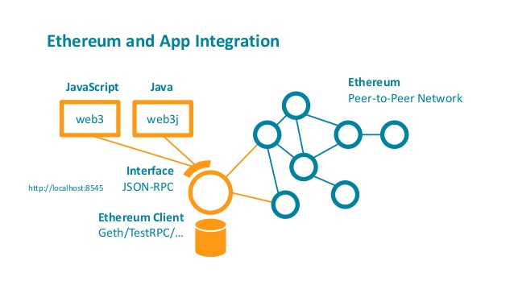
What is TestRPC?
Node.js based Ethereum client
Testing
Development
Uses ethereumjs to simulate full client behavior
Make developing Ethereum applications much faster
Includes all popular RPC functions and features

Slide 31

Blockchain Nodes – Go-Ethereum (Geth)
Official client software
Written in the Go programming language
Client Daemon
Connects to other clients/nodes
Downloads a copy of the Blockchain
Keep it’s copy of the blockchain up to date
Ability to
Mine blocks
Add transactions
Validate the transactions
Execute the transactions

Slide 32
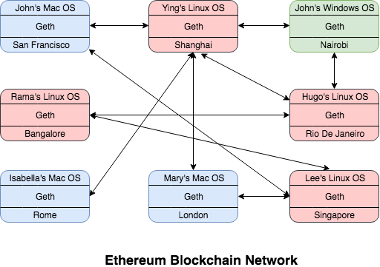
Blockchain Nodes – Go-Ethereum (Geth) (2)
geth console
Command line tool
Connect to your running node
Create and manage accounts
Query the blockchain
Sign and submit transactions
https://geth.ethereum.org/downloads/

Slide 33
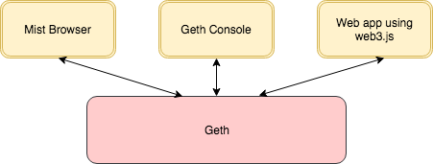
How Is Connected To The Ecosystem
Web3.js
JavaScript library
Interact with a nodes
Build web based DApps
npm install -g web3
if (typeof web3 !== 'undefined') {
web3 = new Web3(web3.currentProvider);
} else {
// set the provider you want from Web3.providers
web3 = new Web3(new Web3.providers.HttpProvider("http://localhost:8545"));
}

Slide 34

IPFS
Inter Planetary File System
Conceptually exactly similar to Swarm
Decentralized storage system
Not related to Ethereum directly
Can be integrated with Ethereum
https://ipfs.io/
Differences between Swarm and IPFS here: https://github.com/ethersphere/go-ethereum/wiki/IPFS-&-SWARM

Slide 35

Summary
Ethereum Virtual Machine – Focuses on providing security and executing untrusted code
Data Location – Storage (persistent location) and memory (temporary location)
Visibility – There are 4 types of visibility (internal, private, external and public)
Fallback Function – Cannot have arguments and cannot return anything
Libraries – Deployed only once at a specific address
Error Handling – There are 3 types (assert, require, revert)
TestRPC – Node.js based Ethereum client which uses ethereumjs to simulate full client behavior
Web3.js – JavaScript library which interacts with a nodes
Truffle – Framework for Compiling, linking and deploying smart contracts

Slide 36
Review of the Week
http://www.kingsland.academy

